Slide 1

Outdoor Leisure Activities and Perceptions of Environmental Degradation in Atlantic Canada
Matthew Stackhouse, PhD student
University of Western Ontario
Dr. Howard Ramos
University of Western Ontario
Dr. Karen Foster
Dalhousie University
Department of Sociology

Slide 2

Background
Importance for examining perceptions: strong predictors for adopting more pro-environmental behaviours and practices.
Critical tool needed for designing, planning and implementing policy design at a local level.
Q1: What promotes perceptions of environment change?
Department of Sociology

Slide 3
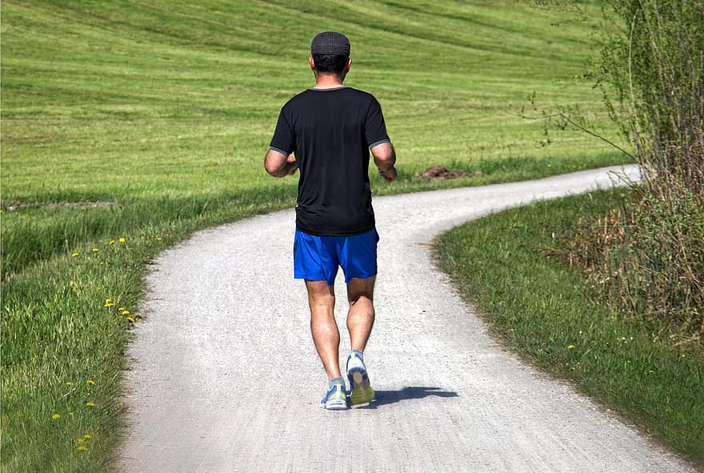
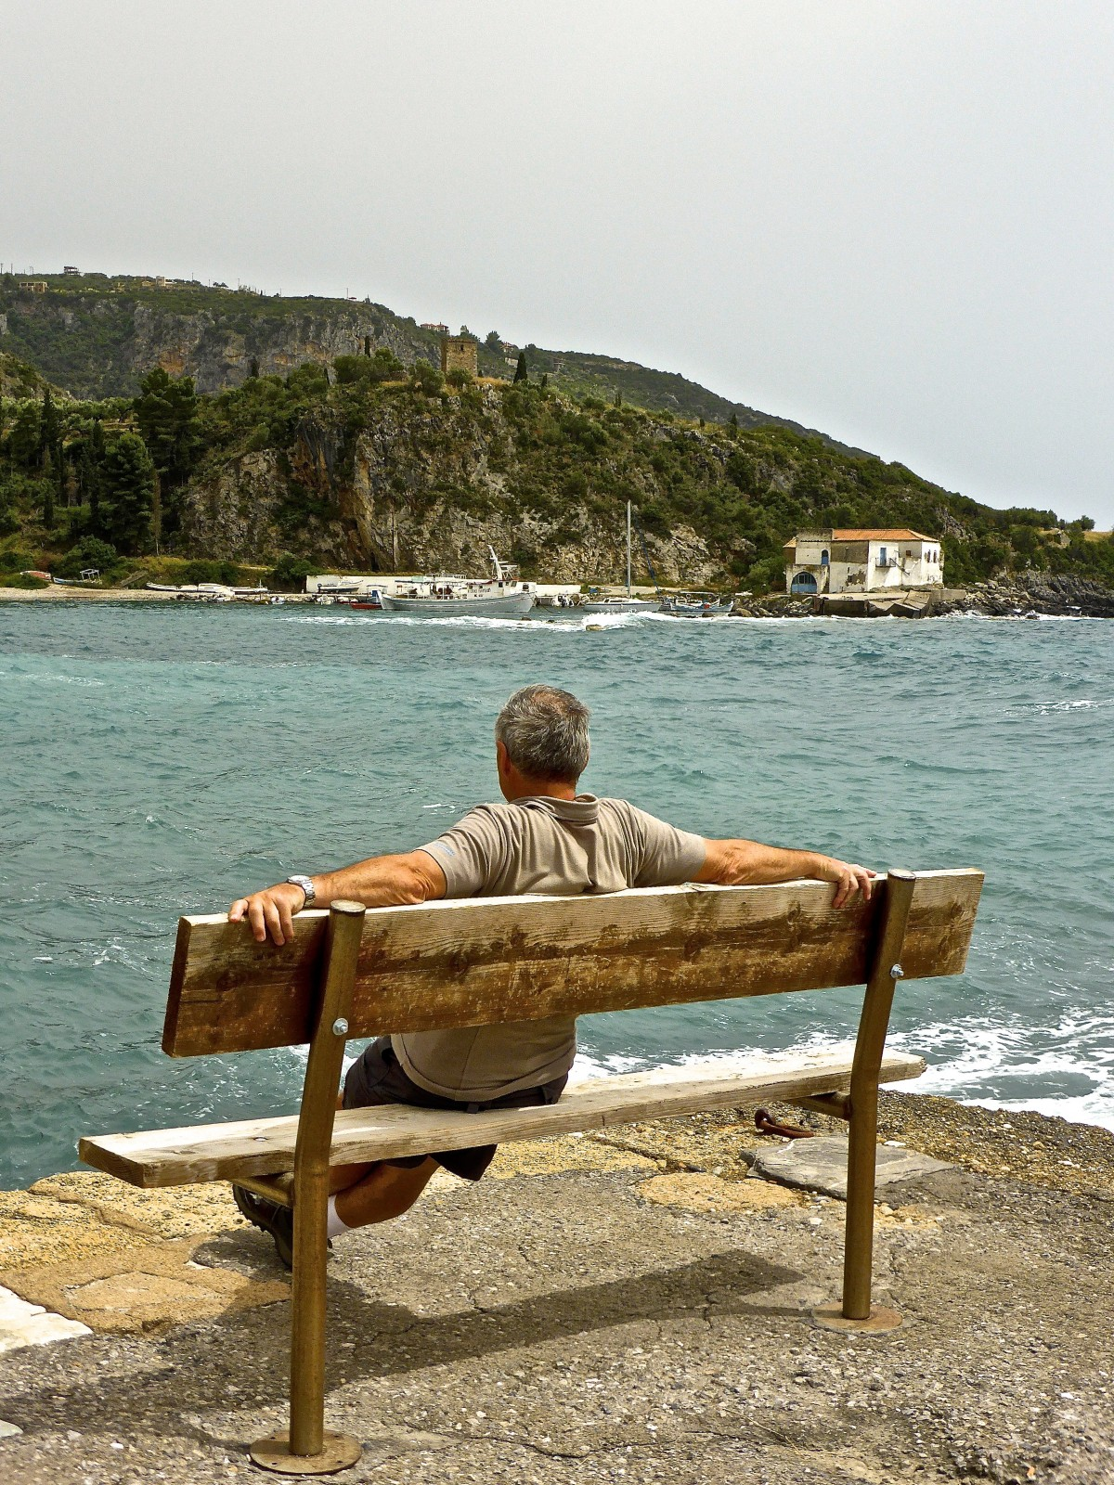

Background
Perceptions may be shaped by increase exposure to environment via leisure practices.
Capital and habitus in a socio—ecological context.
Ecological habitus: “ecologically relevant aspects of habitus.” (Kasper, 2009: 320)
Department of Sociology

Slide 4
Background
Dunlap & Heffernan (1975): original hypotheses for outdoor leisure activities and perceptions of environment change.
Recent work in this research area has refined since (Barnett et al., 2018; Knight & Hao, 2022; Deville et al., 2021).
Q2: Are ‘appreciative’ outdoor activity classes more likely to report perceptions of environment degradation, net of social characteristics?
Q3: How does this compare with other types of outdoor leisure classes?
Department of Sociology

Slide 5


Background: Education
Education linked to environmental concern.
Well-educated more concerned with environmental issues; likely to adopt pro-environmental attitudes, behaviours, etc.
Enables learned-effectiveness.
Q4: Does education explain some or all of the association between outdoor leisure and perceptions of environment degradation?
Department of Sociology

Slide 6
Background: Putting it Together
Ecological habitus: measured as exposure to environments through outdoor leisure activity (practice), and may contribute to perceptions of local climate change.
Leisure outdoor activity and education could yield greater ecological capital stock (e.g., environmental awareness, knowledge, attitudes).
Ecological capital may overlap with cultural capital and other forms of capital (e.g., resources) that intersect with an ecological habitus.
Department of Sociology

Slide 7
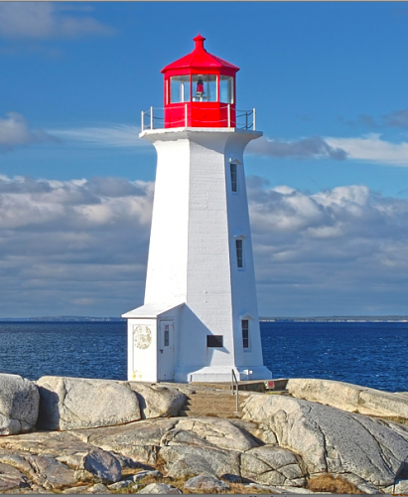
Background: Why Atlantic Canada?
The Atlantic Canadian (Newfoundland and Labrador, New Brunswick, Nova Scotia, and Prince Edward Island) region has experienced substantial environmental change and has a long history of environmental awareness.
Express more pro-environmental
attitudes than the rest of the
country (environics, 2018).
Large rural populations that rely on resource extractive industries (e.g., forestry, agriculture, fishing).
Intensive deforestation, few old growth forest left, industrial pollution, etc.
Department of Sociology

Slide 8
Data
Data: Perceptions of Environmental Change in Atlantic Canada Survey –funded by Future Ocean and Coastal Infrastructure’s (FOCI)
Collection: Online survey between February to April 2021.
Sample size: 1,119.
Department of Sociology

Slide 9
Analytic Sample & Methods
Analytic sample = 1,063
Describe and summarize outdoor leisure activities using Principal Component Analysis (PCA).
Method: Stepwise logistic regressions
Department of Sociology

Slide 10
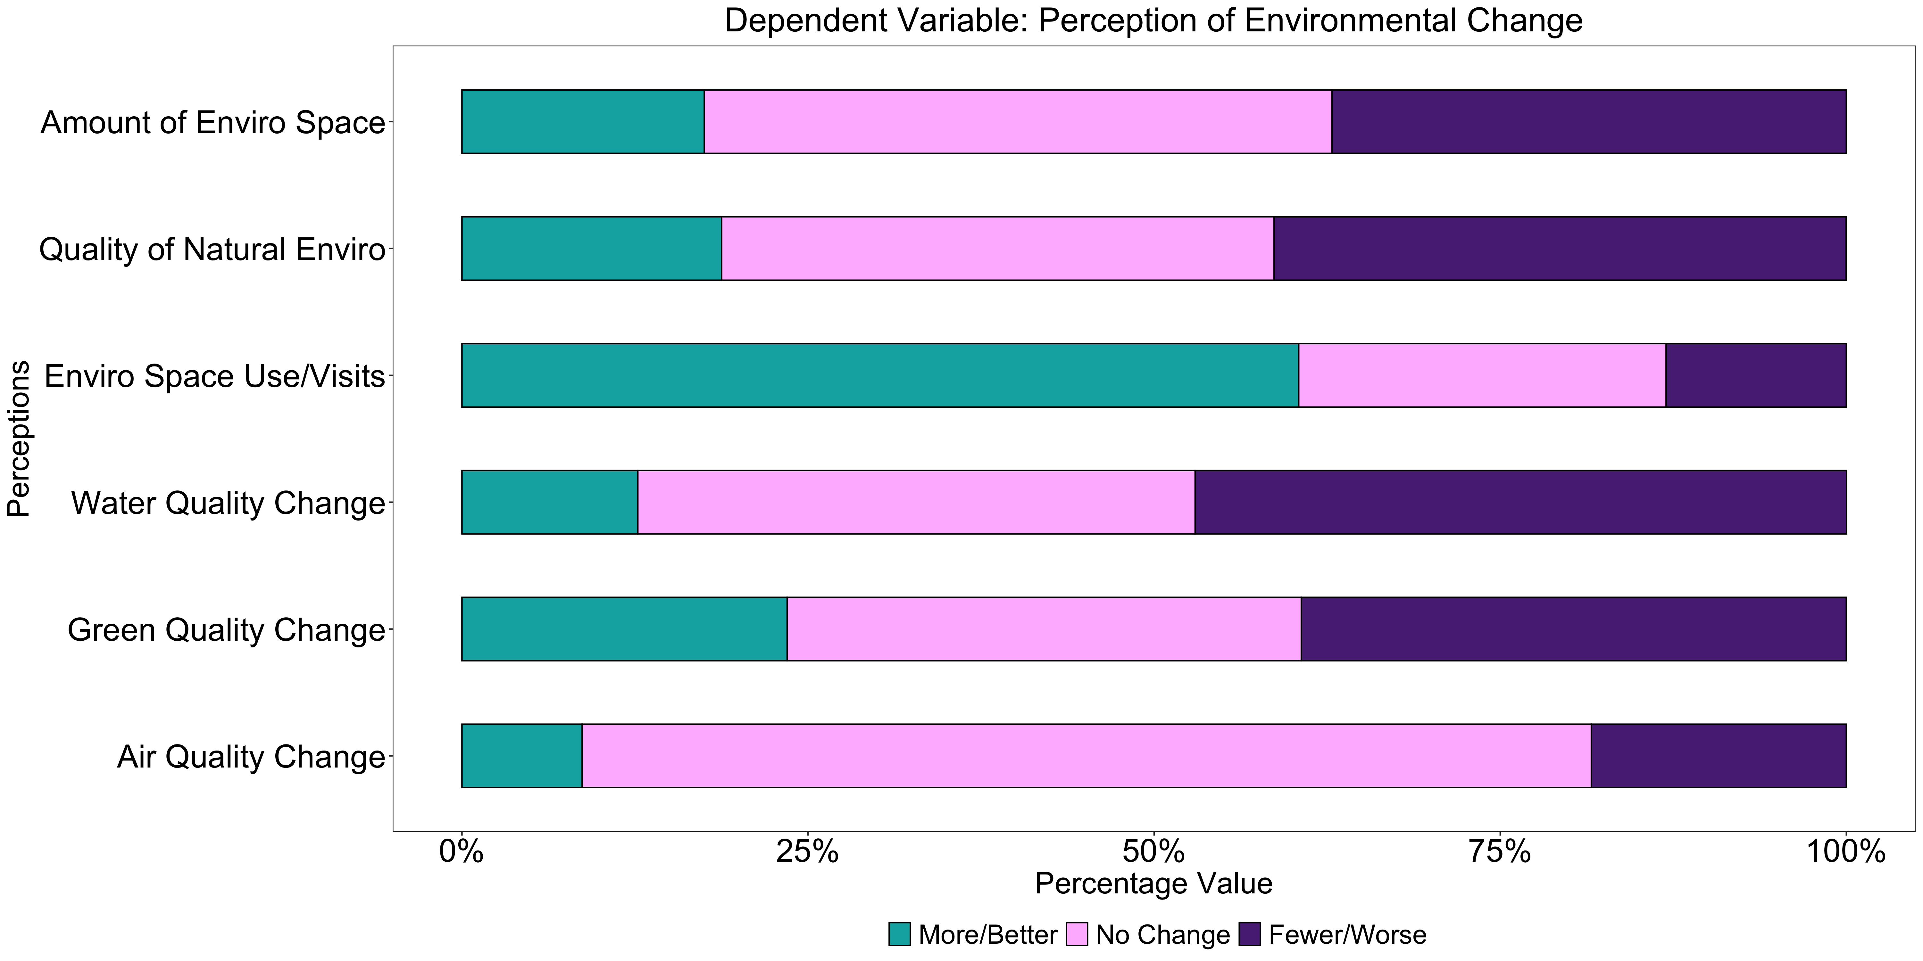
Measures: Dependent Variable
Department of Sociology

Slide 11
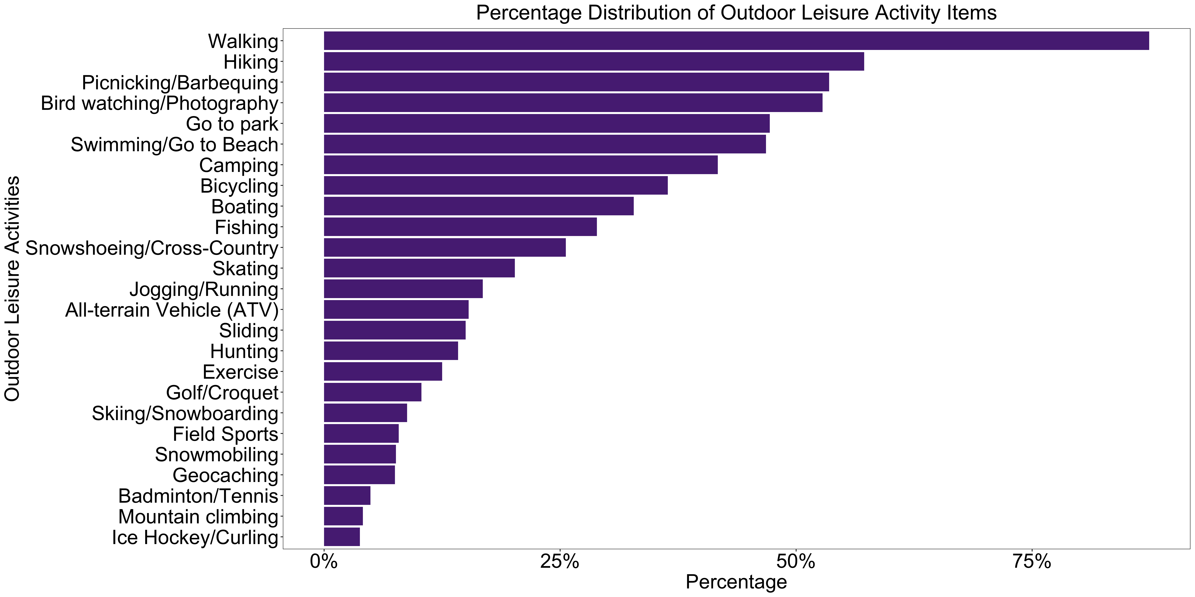
Measures: Independent Variable
Department of Sociology

Slide 12
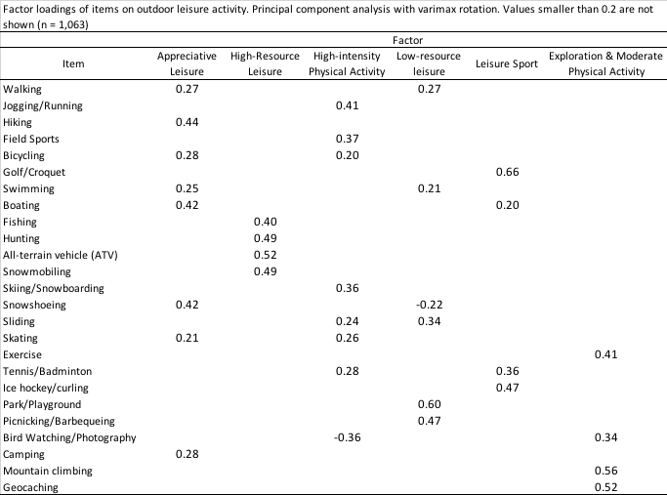
Measures: Principal Component Analysis
Department of Sociology

Slide 13
Measures: Covariates
Education measure:
high school diploma or less,
post-secondary certificate/diploma below bachelors,
bachelor’s degree,
Certificate, diploma, or degree above bachelors
Sociodemographic covariates: gender, respondents age, marital status, immigrant/refugee status, visible minority status, indigenous status, Atlantic province of residence, rural-urban residency.
Socioeconomic covariates: dwelling type and proportion of income spent on housing.
Department of Sociology

Slide 14

Results
Department of Sociology

Slide 15
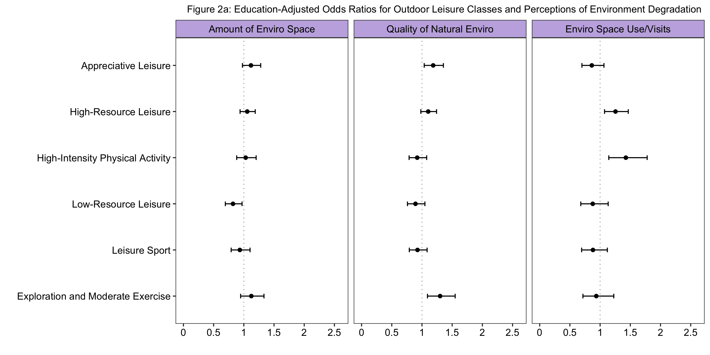
Results
Department of Sociology

Slide 16
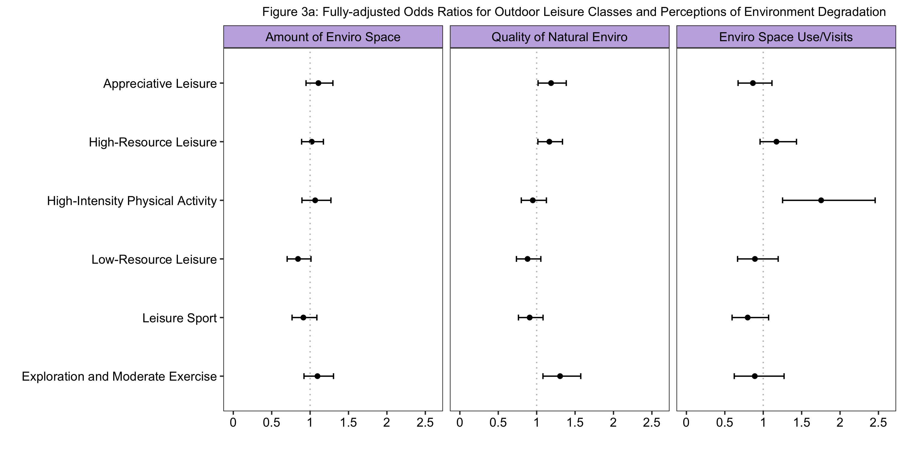
Results
Department of Sociology

Slide 17
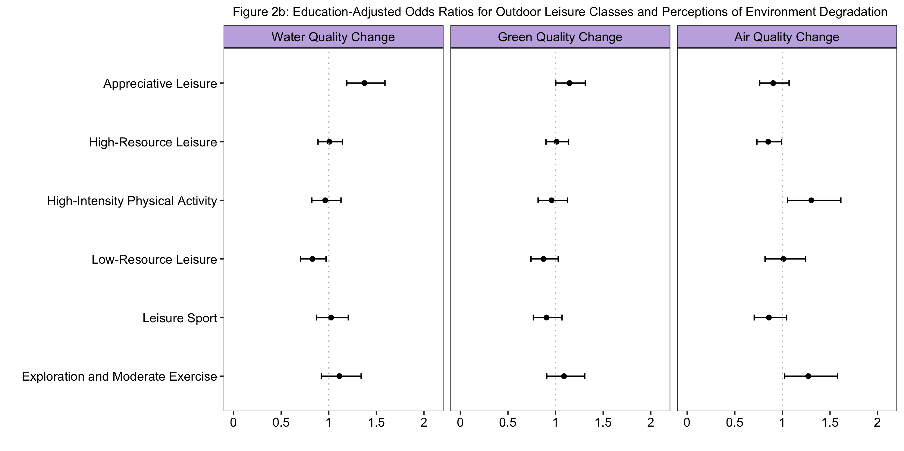
Results
Department of Sociology

Slide 18

Results
Department of Sociology

Slide 19
Discussion of Findings
Appreciative outdoor leisure associated with perception of environment degradation on 3 key indicators (quality of natural environment, water quality, and green space), net of controls.
High-resource leisure, high-intensity PA, or exploration classes associated with select perceptions of degradation.
Each leisure category uniquely shapes perceptions.
Only one category – low-resource leisure – is associated with environment improvement/no change.
Education does not explain perceptions of environment degradation.
Department of Sociology

Slide 20
Discussion of Findings
Results suggest that an ecological habitus comprised of dynamic/intimate exposure to environment terrain may increase sensitivities to perception of environment change.
Those practices are costly and not accessible to all people.
There is likely ecological capital that overlaps with other forms of capital.
Policymakers should explore strategies that encourage and support access to dynamic outdoor leisure and limit barriers to accessing more costly resources.
Department of Sociology

Slide 21
Thank you.
Please email me at mstackh@uwo.ca for any feedback, input, or questions ☺.
Department of Sociology

